Slide 1
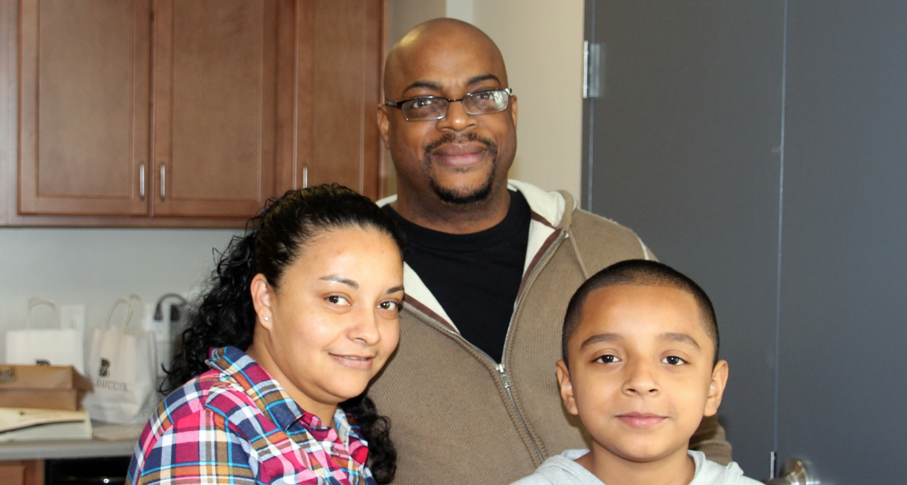
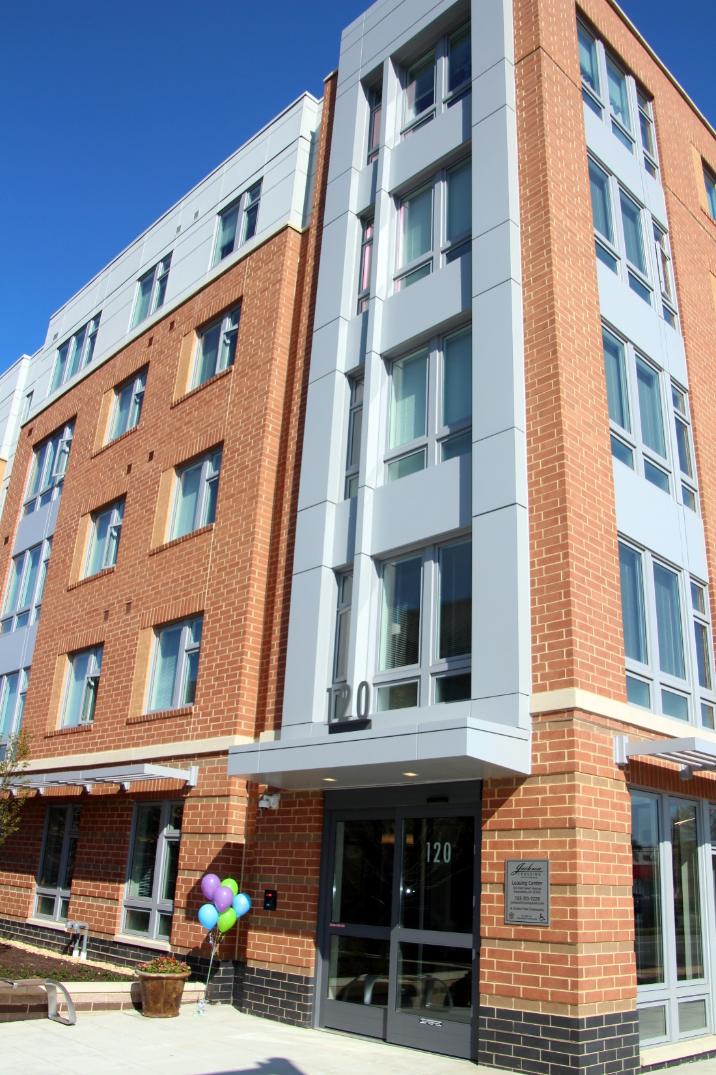
CITIZEN ACADEMY OFFICE OF HOUSING
Tamara Jovovic, Housing Program Manager
March 2020

Slide 2
Office of Housing
Provides landlord-tenant services (complaint resolution, mediation, and relocation assistance)
15-member strong
Develops affordable housing policy
Conducts fair housing testing and training
Provides loans and technical assistance to partners
Provides home purchase assistance and training, foreclosure prevention, and condo governance education
Works to secure affordable units through development
Runs home rehabilitation loan program, and manages rental accessibility grants

Slide 3
Alexandria Redevelopment and Housing Authority (ARHA)
1,084
Owns and operates public housing and affordable housing, including units that serve Alexandria’s lowest income residents
VOUCHERS:
Administers Housing Choice (Section 8) Voucher program to provide greater access to housing on the private market
~1,460 funded out of 1,971 allocated
ARHA Board of Commissioners appointed by City Council

Slide 4
2013 Housing Master Plan
Economy
Equity
Sustainability
Development
Health and Safety
Transportation
HOUSING AFFORDABILITY
Housing options at all incomes, life stages, and abilities
Energy efficient
Healthy and safe
Accessible
Citywide distribution of affordable units to foster social and cultural diversity and mixed-income communities
Emphasis on opportunities in higher-density areas with strong access to transit, jobs, and services
HOUSING MASTER PLAN GOAL: Create new affordability in 2,000 units by 2025

Slide 5
Typical Hourly Wages:
Fast Food Cook: $11.75
Housekeeper: $14.02
City Temporary Front Desk Clerk: $15.12
City Temporary Sports Monitor: $15.71
Retail Salesperson: $16.19
Bank Teller: $16.36
Nursing Aide: $16.67
Parking Lot Attendant: $17.41
Child Care Worker: $17.75
Receptionist: $19.74
EMT: $19.76
Medical Billing Clerk: $21.05
City Law Clerk I: $21.41 (starting)
City Treasury Accountant: $22.48 (starting)
City Human Services Specialist II : $24.79 (starting)
Cardiac Technician: $24.97
ACPS Teacher w/Bachelor’s Degree (Step 1, 220-day contract): $26.65
Auto Mechanic: $27.19
Hotel Front Desk Manager: $27.85
City Urban Planner III: $30.12 (starting)
ACPS Teacher w/Master’s Degree (Step 1, 220-day contract): $30.42
Plumber: $31.07
Electrician: $33.06
Dental Hygienist: $40.79
Computer Programmer: $44.04
City Assistant Fire Chief: $44.38 (starting)
Physical Therapist: $47.40
$35.59/hr (~$74,040/yr)
Hourly wage needed in 2020 to rent an average 1-bedroom apartment ($1,851) in the City (rent assumed to equal 30% of gross income)
WHO CAN AFFORD TO RENT IN THE CITY?
Sources: National Housing Conference 2018 Paycheck to Paycheck (www.nhc.org) with 3.1% inflationary multiplier; City of Alexandria Public Schools 2019-20 Salary Scales; City of Alexandria Job Opportunities webpage (February 11, 2020); City of Alexandria 2019 Market Rent Survey Wage: ((average rent/.3)*12months)/2,080 work hours per year

Slide 6
Typical Hourly Wages:
Fast Food Cook: $11.75
Housekeeper: $14.02
City Temporary Front Desk Clerk: $15.12
City Temporary Sports Monitor: $15.71
Retail Salesperson: $16.19
Bank Teller: $16.36
Nursing Aide: $16.67
Parking Lot Attendant: $17.41
Child Care Worker: $17.75
Receptionist: $19.74
EMT: $19.76
Medical Billing Clerk: $21.05
City Law Clerk I: $21.41 (starting)
City Treasury Accountant: $22.48 (starting)
City Human Services Specialist II : $24.79 (starting)
Cardiac Technician: $24.97
ACPS Teacher w/Bachelor’s Degree (Step 1, 220-day contract): $26.65
Auto Mechanic: $27.19
Hotel Front Desk Manager: $27.85
City Urban Planner III: $30.12 (starting)
ACPS Teacher w/Master’s Degree (Step 1, 220-day contract): $30.42
Plumber: $31.07
Electrician: $33.06
Dental Hygienist: $40.79
Computer Programmer: $44.04
City Assistant Fire Chief: $44.38 (starting)
Physical Therapist: $47.40
$35.59/hr (~$74,040/yr)
Hourly wage needed in 2020 to rent an average 1-bedroom apartment ($1,851) in the City (rent assumed to equal 30% of gross income)
WHO CAN AFFORD TO RENT IN THE CITY?
Sources: National Housing Conference 2018 Paycheck to Paycheck (www.nhc.org) with 3.1% inflationary multiplier; City of Alexandria Public Schools 2019-20 Salary Scales; City of Alexandria Job Opportunities webpage (February 11, 2020); City of Alexandria 2019 Market Rent Survey Wage: ((average rent/.3)*12months)/2,080 work hours per year

Slide 7
DEMAND FOR AFFORDABLE HOUSING DRIVEN BY…

Slide 8
Growing gap in income vs housing costs
Rent
Residential assessment
Income
2000-2019 INCOME VS HOUSING TRENDS
Declining federal housing funding
60% AMI
87%
Loss of ~16,000 market-affordable units (2000-2019)
50% AMI
Demographic changes
2000
2019
14%
GROWTH IN LEISURE AND HOSPITALITY JOBS
Projected regional job growth in lower-wage sectors (2017-2021)
13%
GROWTH IN CONSTRUCTION JOBS
12%
GROWTH IN EDUCATION AND HEALTH SERVICE JOBS

Slide 9
MOST LOW- TO MODERATE-INCOME ALEXANDRIANS
(w/incomes up to $75,000)
SPEND TOO MUCH ON HOUSING
27%
Spend => 30% of income on housing (at the expense of healthcare, education, daycare, and savings)
Source: 2013-2017 American Community Survey 5-Year Estimates
73%
73% of low- to moderate-income renter households are housing cost burdened
15,187 households
MOST ALEXANDRIA WORKERS COMMUTE INTO THE CITY
~2,000
# OF INDIVIDUALS ON ARHA’S GENERAL PUBLIC HOUSING WAITING LIST
Source: 2009-2013 American Community Survey Estimates—County to County Commuting Flows
75% of Alexandrian’s workforce lives outside the City

Slide 10
MARKET AFFORDABLE
non-subsidized units affordable due to their age, amenities, condition, and/or location
COMMITTED AFFORDABLE
units receiving assistance (local and/or federal) or made affordable through developer contributions
Rental and for-sale set-aside units secured through development process, including through bonus density and height
Publicly assisted housing units (public housing, nonprofit housing projects, HUD-funded affordable units in privately-owned properties)
AFFORDABLE CONDOMINIUMS
units assessed up to $249,000
HOUSING OPPORTUNITY
~3% citywide housing stock
~5% citywide housing stock
~11% citywide housing stock

Slide 11
Affordability Defined
2019 Area Median Income | 1-Person Household | 4-Person Household
20% AMI and below | Up to $17,000 | Up to $24,260
30% AMI | $25,500 | $36,400
40% AMI | $34,000 | $48,520
50% AMI | $42,500 | $60,650
60% AMI | $51,000 | $72,780
80% AMI | $68,000 | $97,040
100% AMI | $85,000 | $121,300
COMMITTED AFFORDABLE RENTALS
COMMITTED AFFORDABLE HOMEOWNERSHIP
Sources: 2019 HUD Income Limits for 30% and 50% AMI for Washington-Arlington-Alexandria, DC-VA-MD HUD Metro Fair Market Rent Area); FY 2019 Multifamily Tax Subsidy Project Income Limits for 60% AMI; and Office of Housing for 40% AMI and Mathematical 80% AMI

Slide 12
Housing Master Plan Progress
January 2014-December 2019
2,000 UNITS WITH NEW AFFORDABILITY

Slide 13
HOW AFFORDABLE HOMES GET BUILT, PRESERVED, AND ENHANCED
TOOL #1: BONUS DENSITY + HEIGHT
TOOL #2: VOLUNTARY DEVELOPER CONTRIBUTIONS TO HOUSING TRUST FUND + REVENUE FROM MEALS TAX INCREASE + HOME/CDBG
ZONING + FINANCING
PARTNERSHIPS
TODAY’S CHALLENGE!
$40k
$80-$95k
INNOVATION
CITY INVESTMENT NEEDED TO CONSTRUCT ONE NEW AFFORDABLE UNIT
2013
2019

Slide 14
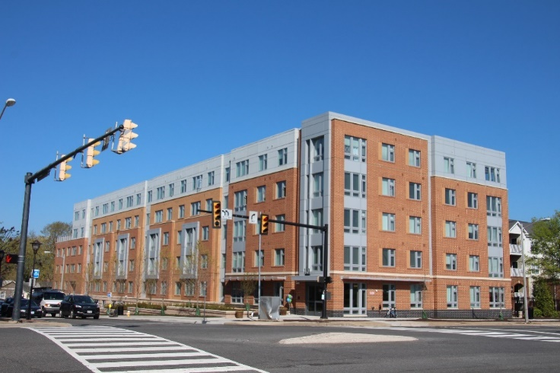
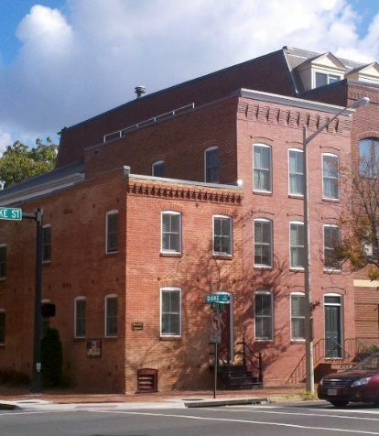
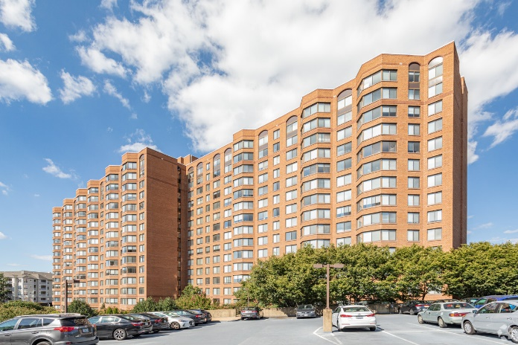
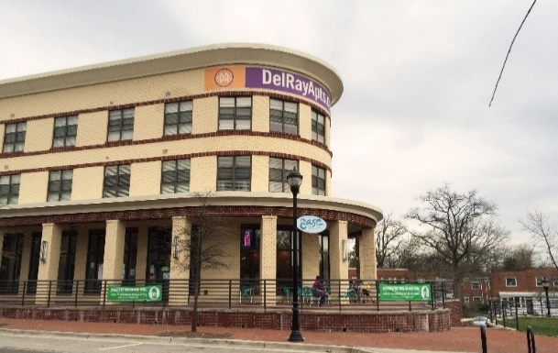
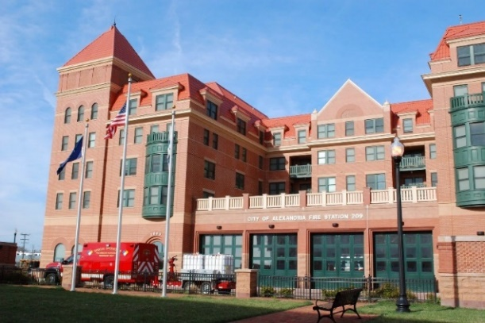
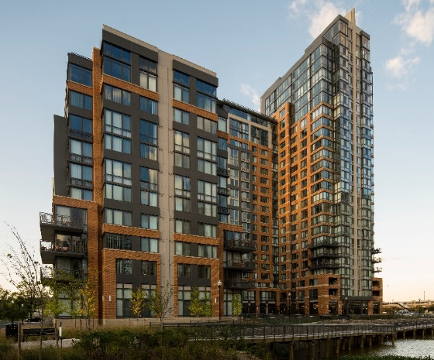
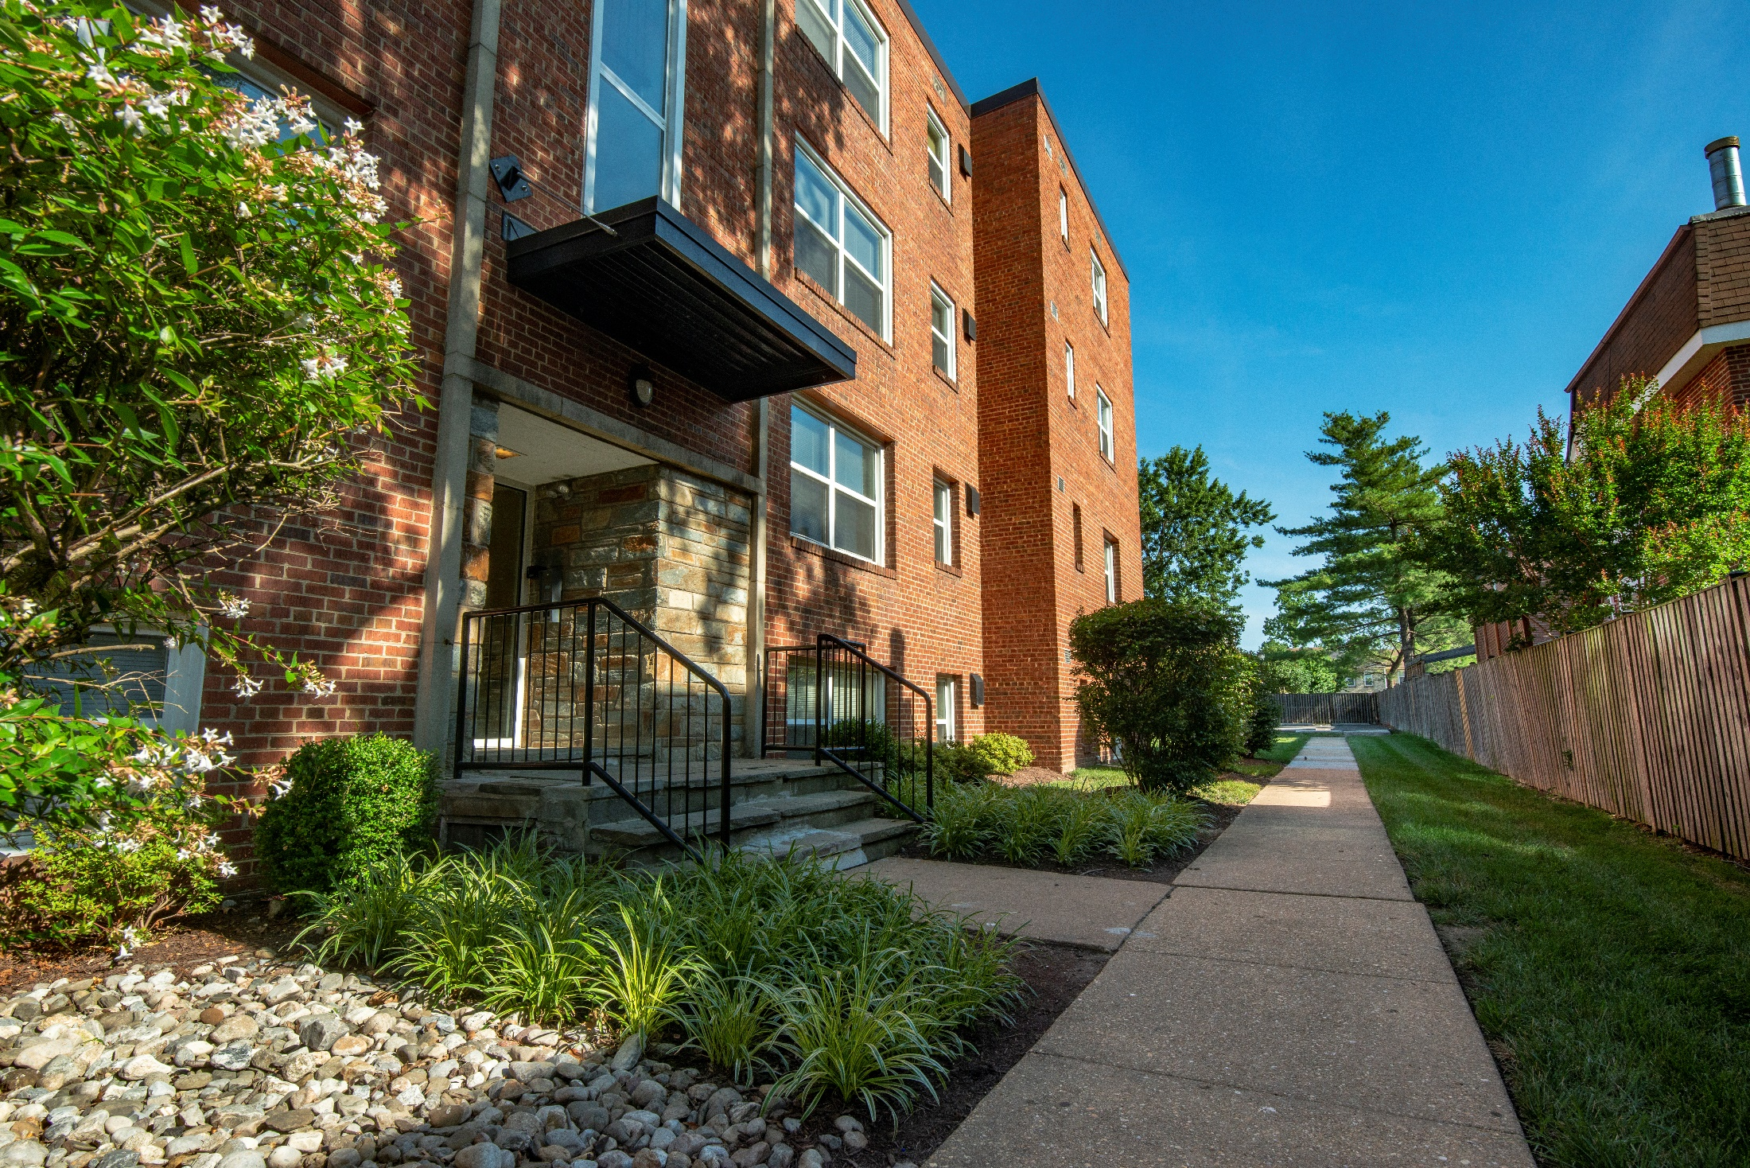
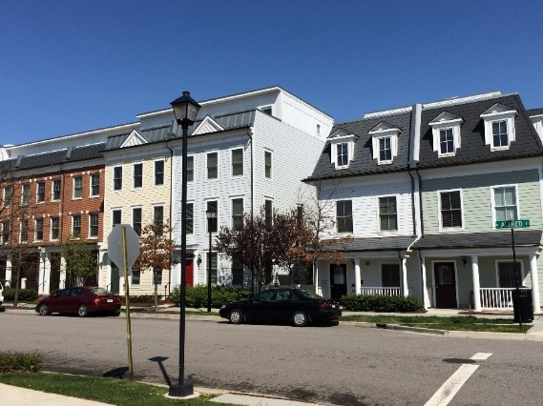
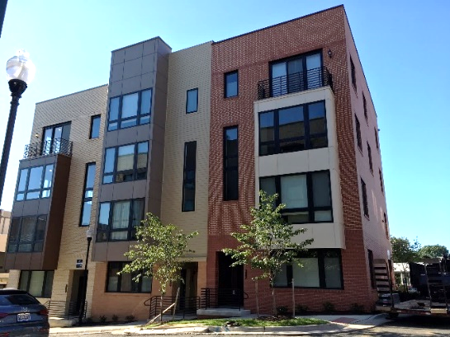
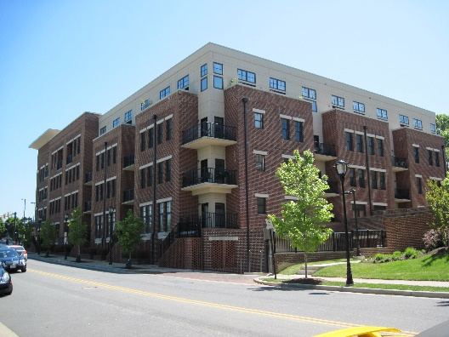
MANY PROJECT TYPES:
SET-ASIDE UNITS IN PRIVATE DEVELOPMENT
100% AFFORDABLE OR MIXED-INCOME
CO-LOCATED WITH PUBLIC USE
BUILT ON PUBLIC LAND
INFILL WITH GROUND LEASE
DEVELOPMENT RIGHTS IN LARGER PROJECT
MIXED-USE WITH COMPLEMENTARY OR COMMERCIAL USE
PARTNERSHIP WITH RELIGIOUS INSTITUTION
SENIOR HOUSING
MIXED-INCOME
JOINT VENTURE WITH PRIVATE SECTOR

Slide 15
Integrating Housing Opportunity into Planning
2019 LANDMARK MALL establish a target for new affordable housing through the zoning process; permit bonus density and height; co-locate housing with community facilities; build partnerships.
2012 BEAUREGARD:
commitment to preserve 800 affordable units with 50% serving very-low income households; relocation coordinator hired; placement into Southern Towers affordable units and referrals to other housing resources and city services.
2019 GREEN BUILDING POLICY
2019-2021 ARLANDRIA/DEL RAY PLAN UPDATES
2017 NORTH POTOMAC YARD: permit bonus densities of 30%; allow for potential ARHA replacement units; integrate universal design and incorporate visitability features, when feasible; permit micro-units; encourage colocation of affordable housing, including senior or assisted living, with future civic, municipal, and other uses where possible.
2015 OAKVILLE TRIANGLE: 65 units (mostly studios) affordable at 60% AMI approved for Triangle site to accommodate likely future workers; other projects in Route 1 area will follow the Housing Master Plan and contribution formula.
2017 OLD TOWN NORTH: permit bonus densities of 30%; prioritize one-for-one on-site replacement of Resolution 830 units within the plan area; encourage artist housing; incorporate universal design, including visitability features.
2018 SOUTH PATRICK STREET: preserve housing opportunity and affordability along Route 1 South through redevelopment and additional density; ensure eligible tenants have the right to return and receive support and assistance to mitigate impacts of temporary relocation
2015 EISENHOWER WEST:
a range of affordable housing options throughout Plan area; co-locate housing with a municipal facility; permit bonus densities of 30% or more particularly where taller heights are allowed.
2020 EISENHOWER EAST

